Slide 1
CHAPTER 10:
Introducing Probability
The Basic Practice of Statistics
6th Edition
Moore / Notz / Fligner
Lecture PowerPoint Slides
Notes:
Basic Practice of Statistics - 3rd Edition
Chapter 5

Slide 2
Chapter 10 Concepts
The Idea of Probability
Probability Models
Probability Rules
Finite and Discrete Probability Models
Continuous Probability Models

Slide 3
Chapter 10 Objectives
Describe the idea of probability
Describe chance behavior with a probability model
Apply basic rules of probability
Describe finite and discrete probability models
Describe continuous probability models
Define random variables

Slide 4
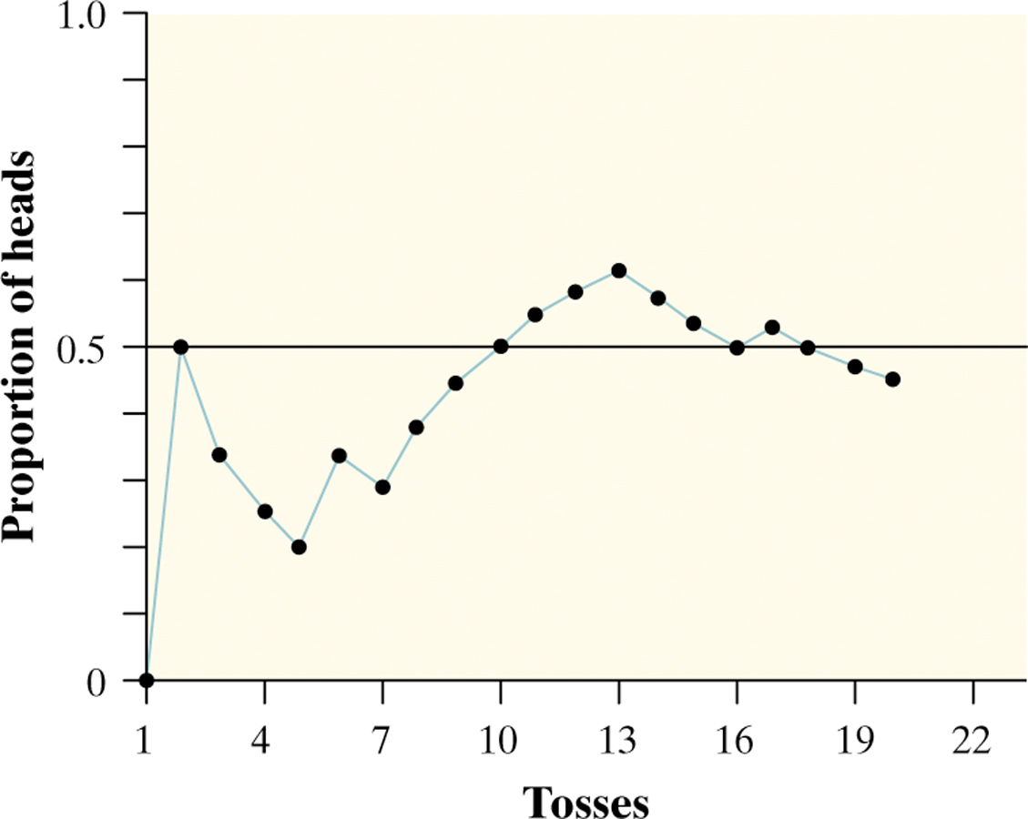

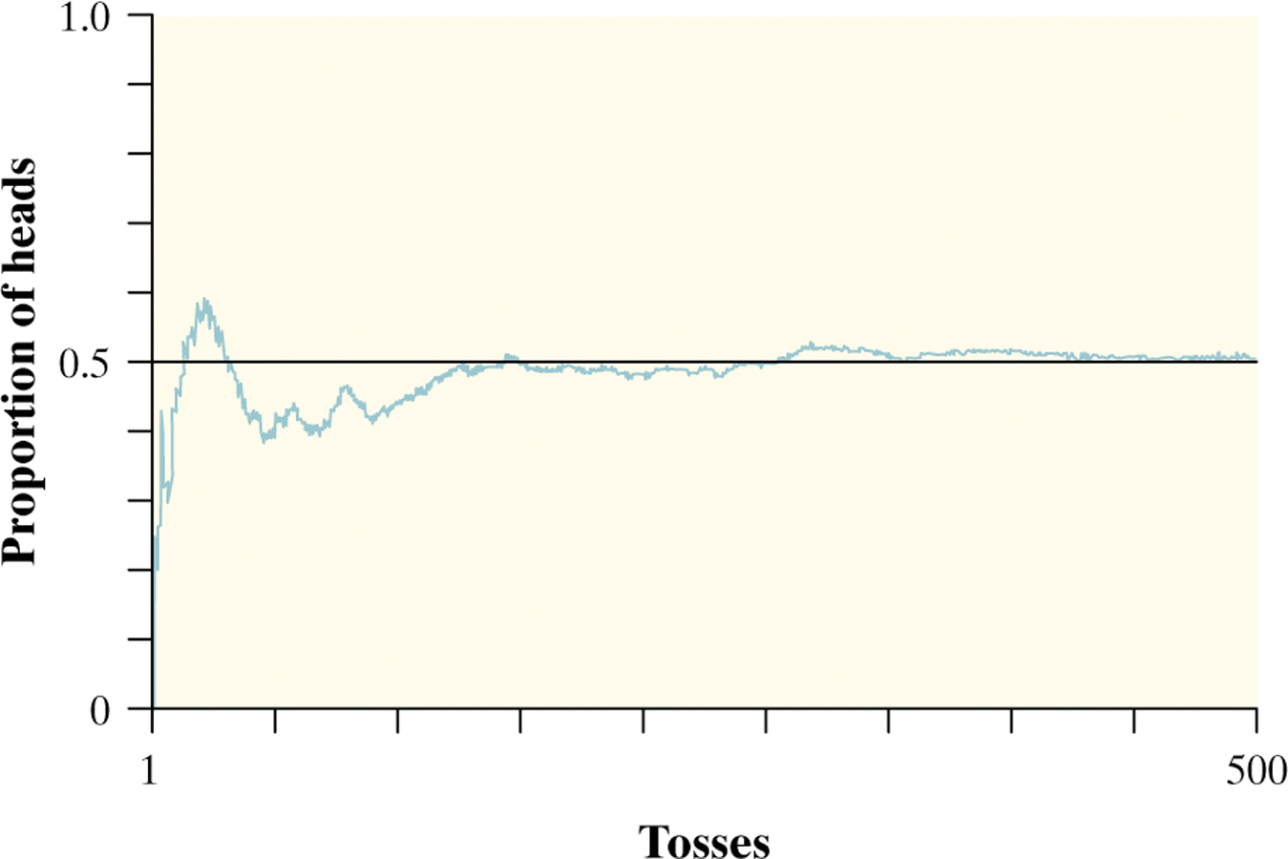
The Idea of Probability
Chance behavior is unpredictable in the short run, but has a regular and predictable pattern in the long run.
We call a phenomenon random if individual outcomes are uncertain but there is nonetheless a regular distribution of outcomes in a large number of repetitions.
The probability of any outcome of a chance process is the proportion of times the outcome would occur in a very long series of repetitions.

Slide 5
Myths About Randomness
The idea of probability seems straightforward. However, there are several myths of chance behavior we must address.
The myth of short-run regularity:
The idea of probability is that randomness is predictable in the long run. Our intuition tries to tell us random phenomena should also be predictable in the short run. However, probability does not allow us to make short-run predictions.
The myth of the “law of averages”:
Probability tells us random behavior evens out in the long run. Future outcomes are not affected by past behavior. That is, past outcomes do not influence the likelihood of individual outcomes occurring in the future.

Slide 6
Probability Models
Descriptions of chance behavior contain two parts: a list of possible outcomes and a probability for each outcome.
The sample space S of a chance process is the set of all possible outcomes.
An event is an outcome or a set of outcomes of a random phenomenon. That is, an event is a subset of the sample space.
A probability model is a description of some chance process that consists of two parts: a sample space S and a probability for each outcome.

Slide 7
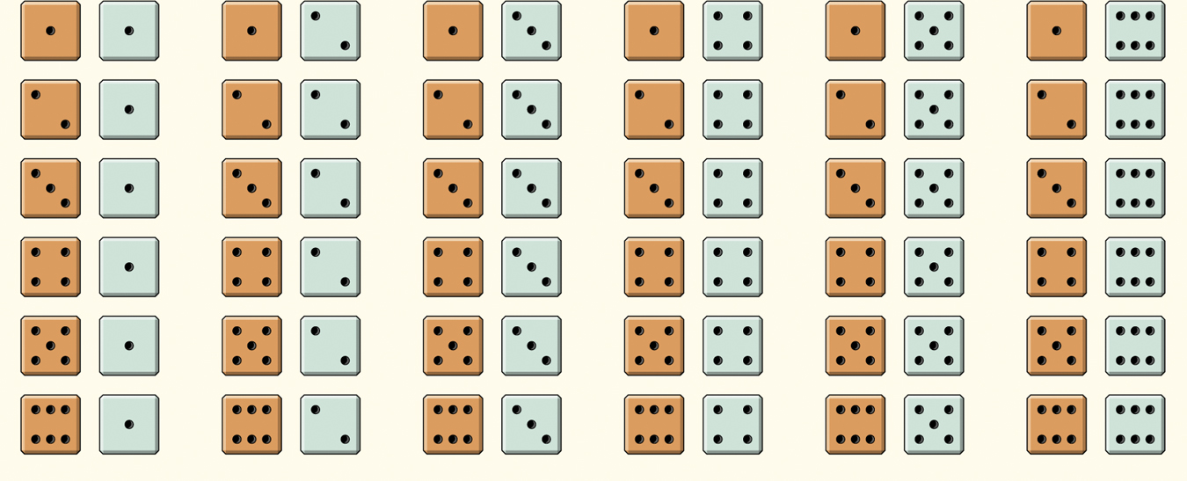
Probability Models
Example: Give a probability model for the chance process of rolling two fair, six-sided dice―one that’s red and one that’s green.
Sample Space
36 Outcomes
Since the dice are fair, each outcome is equally likely.
Each outcome has probability 1/36.

Slide 8
Probability Rules
Any probability is a number between 0 and 1.
All possible outcomes together must have probability 1.
If two events have no outcomes in common, the probability that one or the other occurs is the sum of their individual probabilities.
The probability that an event does not occur is 1 minus the probability that the event does occur.
Rule 1. The probability P(A) of any event A satisfies 0 ≤ P(A) ≤ 1.
Rule 2. If S is the sample space in a probability model, then P(S) = 1.
Rule 3. If A and B are disjoint, P(A or B) = P(A) + P(B).
This is the addition rule for disjoint events.
Rule 4: For any event A, P(A does not occur) = 1 – P(A).

Slide 9
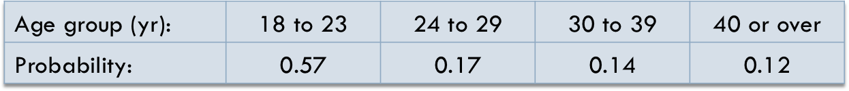
Probability Rules
Distance-learning courses are rapidly gaining popularity among college students. Randomly select an undergraduate student who is taking distance-learning courses for credit and record the student’s age. Here is the probability model:
Show that this is a legitimate probability model.
Find the probability that the chosen student is not in the traditional college age group (18 to 23 years).
Each probability is between 0 and 1 and 0.57 + 0.17 + 0.14 + 0.12 = 1
P(not 18 to 23 years) = 1 – P(18 to 23 years)
= 1 – 0.57 = 0.43

Slide 10
Finite and Discrete Probability Models
One way to assign probabilities to events is to assign a probability to every individual outcome, then add these probabilities to find the probability of any event. This idea works well when there are only a finite (fixed and limited) number of outcomes.
A probability model with a finite sample space is called finite.
To assign probabilities in a finite model, list the probabilities of all the individual outcomes. These probabilities must be numbers between 0 and 1 that add to exactly 1. The probability of any event is the sum of the probabilities of the outcomes making up the event.

Slide 11
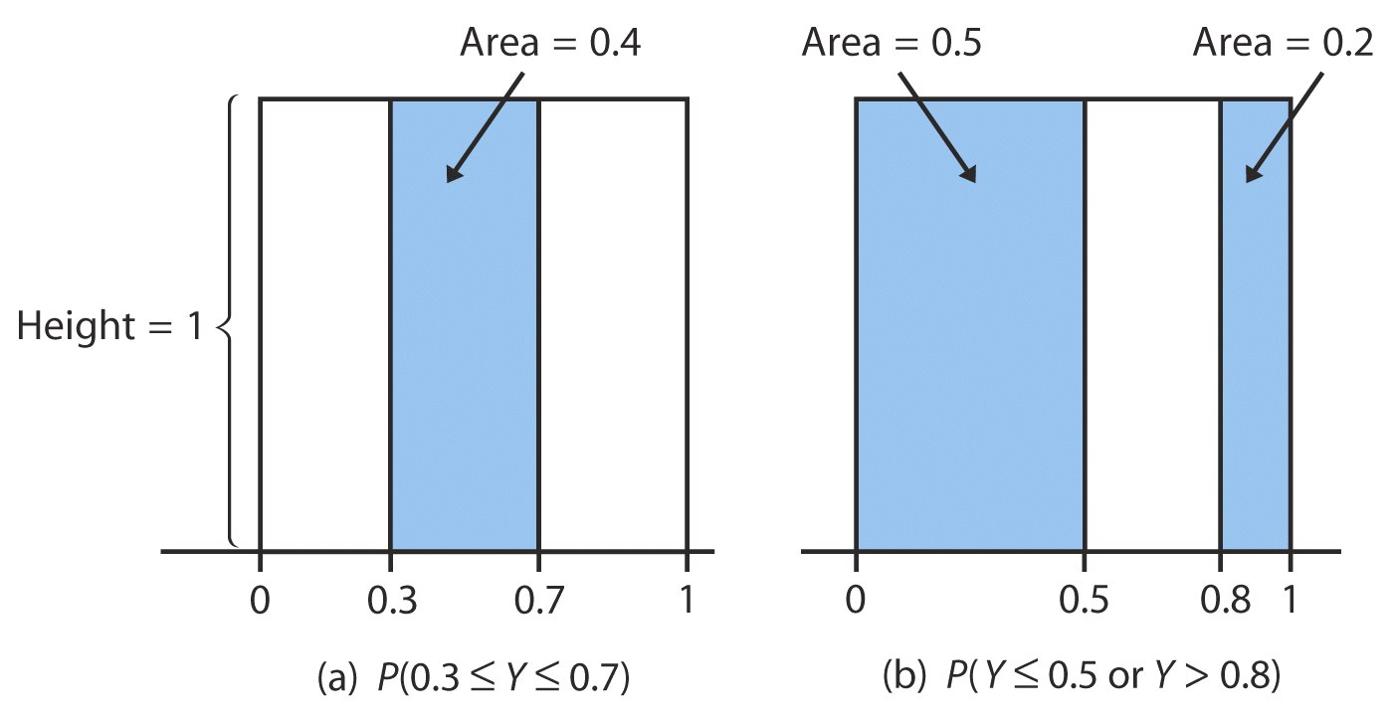
Continuous Probability Models
Suppose we want to choose a number at random between 0 and 1, allowing any number between 0 and 1 as the outcome.
We cannot assign probabilities to each individual value because there is an infinite interval of possible values.
A continuous probability model assigns probabilities as areas under a density curve. The area under the curve and above any range of values is the probability of an outcome in that range.
Example: Find the probability of getting a random number that is less than or equal to 0.5 OR greater than 0.8.
Uniform
Distribution
P(X ≤ 0.5 or X > 0.8)
= P(X ≤ 0.5) + P(X > 0.8)
= 0.5 + 0.2
= 0.7

Slide 12
Normal Probability Models
Often the density curve used to assign probabilities to intervals of outcomes is the Normal curve.
  Normal distributions are probability models:
  Probabilities can be assigned to intervals of outcomes using the Standard Normal probabilities in Table A.
  The technique for finding such probabilities is found in Chapter 3.

Slide 13
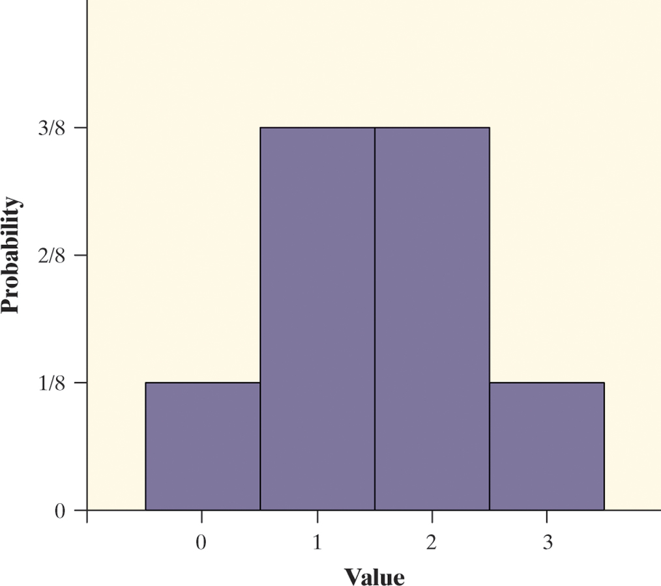
Random Variables
A probability model describes the possible outcomes of a chance process and the likelihood that those outcomes will occur.
A numerical variable that describes the outcomes of a chance process is called a random variable. The probability model for a random variable is its probability distribution.
A random variable takes numerical values that describe the outcomes of some chance process.
The probability distribution of a random variable gives its possible values and their probabilities.
Example: Consider tossing a fair coin 3 times.
Define X = the number of heads obtained
X = 0: TTT
X = 1: HTT THT TTH
X = 2: HHT HTH THH
X = 3: HHH
Value | 0 | 1 | 2 | 3
Probability | 1/8 | 3/8 | 3/8 | 1/8

Slide 14
Discrete Random Variable
There are two main types of random variables: discrete and continuous. If we can find a way to list all possible outcomes for a random variable and assign probabilities to each one, we have a discrete random variable.
A discrete random variable X takes a fixed set of possible values with gaps between. The probability distribution of a discrete random variable X lists the values x_{i} and their probabilities p_{i}:
Value: x₁ x₂ x₃ …
Probability: p₁ p₂ p₃ …
The probabilities p_{i} must satisfy two requirements:
Every probability p_{i} is a number between 0 and 1.
The sum of the probabilities is 1.
To find the probability of any event, add the probabilities p_{i} of the particular values x_{i} that make up the event.

Slide 15
Continuous Random Variable
Discrete random variables commonly arise from situations that involve counting something. Situations that involve measuring something often result in a continuous random variable.
A continuous random variable Y takes on all values in an interval of numbers. The probability distribution of Y is described by a density curve. The probability of any event is the area under the density curve and above the values of Y that make up the event.
The probability model of a discrete random variable X assigns a probability between 0 and 1 to each possible value of X.
A continuous random variable Y has infinitely many possible values. All continuous probability models assign probability 0 to every individual outcome. Only intervals of values have positive probability.

Slide 16
Chapter 10 Objectives Review
Describe the idea of probability
Describe chance behavior with a probability model
Apply basic rules of probability
Describe finite and discrete probability models
Describe continuous probability models
Define random variables

